Slide 1
SECURE DATA HIDING IN IMAGE USING
STEGANOGRPHY
CAPSTONE PROJECT
Presented By : Muttu Handigund
Student Name : Muttu Handigund
College Name : REVA University
Department : Computer Science and Engineering

Slide 2
OUTLINE
Problem Statement
Technology used
Wow factor
End users
Result
Conclusion
Git-hub Link
Future scope

Slide 3
Problem Statement
With the increasing need for secure communication, hiding data in images provides an additional layer of security. Traditional encryption methods make hidden messages obvious, while steganography ensures covert communication by embedding secret information within images without noticeable changes.

Slide 4
Technology used
1. Python
2. OpenCV for image processing
3. NumPy for array manipulations
4. Cryptography for secure encoding
5. VS Code for development
6. GitHub for version control

Slide 5
Wow factors
Provides an invisible layer of security
Hard to detect without the correct passcode
Can be applied to personal or confidential data transfer
Lightweight and efficient implementation

Slide 6
End users
Government Agencies – Secure communication and intelligence operations
Corporate Organizations – Protection of sensitive business data
Individuals – Personal data privacy and security
Cybersecurity Professionals – Research and development in secure data transfer

Slide 7
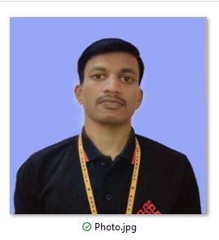
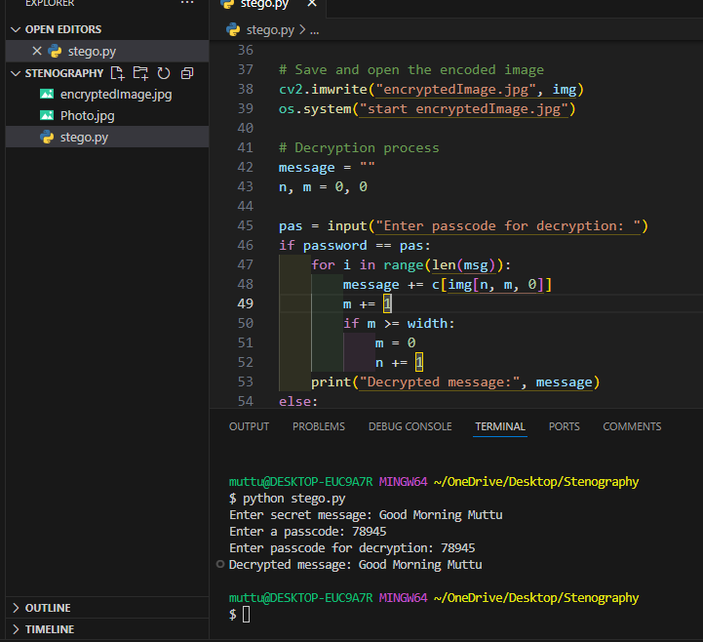
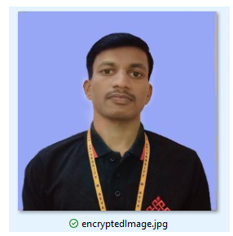
Results
Input
Output

Slide 8
Conclusion
Steganography is a powerful technique for secure data transmission. This project demonstrates how messages can be securely embedded within images while maintaining confidentiality and integrity through a passcode system.

Slide 9
GitHub Link
GitHub Repository: https://github.com/MuttuVittal818/Stenography.git

Slide 10
Future scope(optional)
Enhancing Security – Adding extra encryption layers before embedding messages
Expanding Media Support – Implementing audio and video steganography
User-Friendly Interface – Developing a GUI for non-technical users
AI Integration – Automating steganography detection and prevention techniques

Slide 11
THANK YOU

